Slide 1
Problem Solving Using Computers
C-Programming

Slide 2
Constant values
Fixed values that do not change during the execution of a program.

Slide 3
1. Integer Constants
Combination of [0-9] with sign
No fractional part.
They can be in decimal, octal, or hexadecimal formats:
Decimal: 123
Octal: 0123 (starts with 0)
Hexadecimal: 0x123 or 0X123 (starts with 0x or 0X)
int binaryValue = 0b1010; // Binary for decimal 10

Slide 4
8-bit signed integer can store numbers
–128 to +127,
stored using two’s complement representation in memory.
Bit allocation
1 bit is used for the sign (most significant bit, MSB).
0 → positive number (or zero)
1 → negative number
7 bits are used for the magnitude (absolute value).

Slide 5
Positive numbers (0 to 127)
+5 → 00000101
+127 → 01111111
Negative numbers (–1 to –128)
Stored in two’s complement:
Write the absolute value in binary.
Invert all bits (one’s complement).
Add 1 to the result.
Example: –5
5 in binary → 00000101
Invert bits → 11111010
Add 1 → 11111011 So –5 is stored as 11111011.

Slide 6
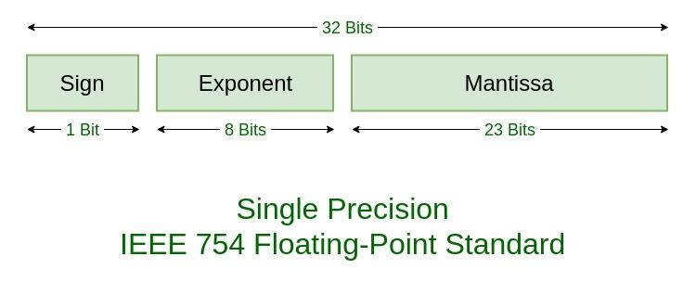
2. Floating-Point Constants
Floating-point constants represent real numbers with a fractional part.
Example: 3.14, -0.001, 6.022e23 (scientific notation)

Slide 7
Positive number: 19.125
Binary: 10011.001₂
Normalize 1.0011001×2⁴
0 10000011 00110010000000000000000
2⁴X (0.203125+1)= 19.125

Slide 8
Character Constants
Character constants represent single characters enclosed in single quotes (' ').
Example: 'A', 'z', '#’
5 and ‘5’
‘\n’ ‘ \na’ ‘5’ 5

Slide 9
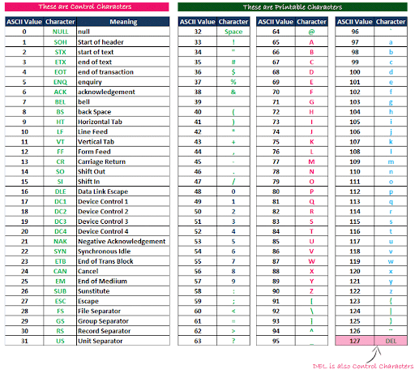

Slide 10
String Constants
String constants are sequences of characters enclosed in double quotes (" ").
Example: "Hello", "C Programming“
5 , ‘5’ , “5” a ‘a’ “a”

Slide 11
formatted string –
String + format specifier to control how data is displayed or stored.
printf() → for output to screen
scanf() → for input from user
Int a=23,b=56
printf("Integer: %d\n", a)

Slide 12
How to create constant
Using const keyword
it tells the compiler that the variable’s value cannot be changed after initialization.
const Int g=10;

Slide 13
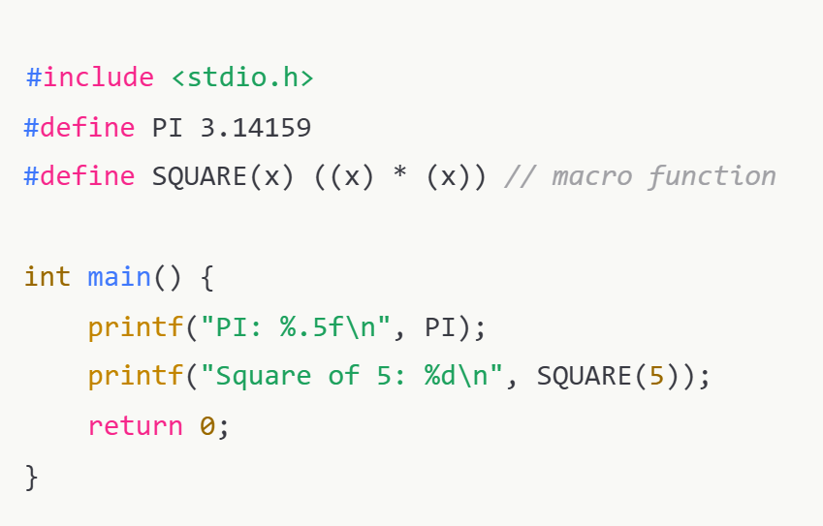
Preprocessor Macro (#define)
Definition: A text replacement done by the preprocessor before compilation.

Slide 14
Key Points:
No type checking — just raw text substitution.
No memory storage — value is inserted everywhere it’s used.
Can define constants and macro functions.
Debugging can be harder (because substitution happens before compilation).

Slide 15
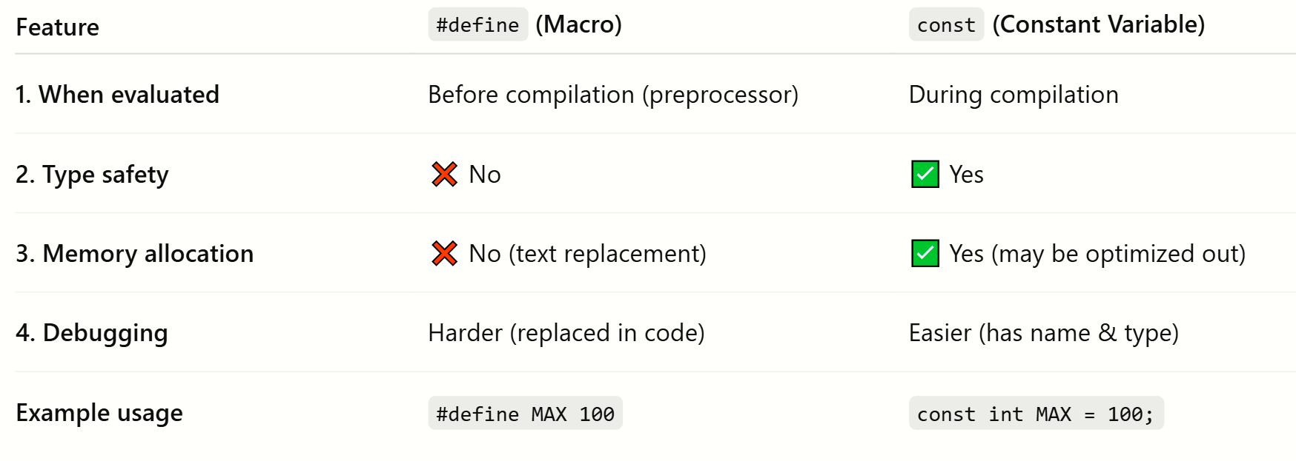

Slide 16
Enums
Enums are designed to represent integral symbolic constants.
enum RGB { RED, GREEN, BLUE };
// RED=0, GREEN=1, BLUE=2
By default, the first constant is 0, and each following constant increments by 1.
You can explicitly set values.

Slide 17
